Slide 1
CS158B Network Management with Web Services Project 3 Presentation
Sri Sreedharan, Thanh Au, Kai - Ting (Danil) Ko, Wilson Yee

Slide 2
Basic SNMP Operations
Users can perform basic SNMP operations
Status
Netstatus
Walk
Get
Test
Translate

Slide 3
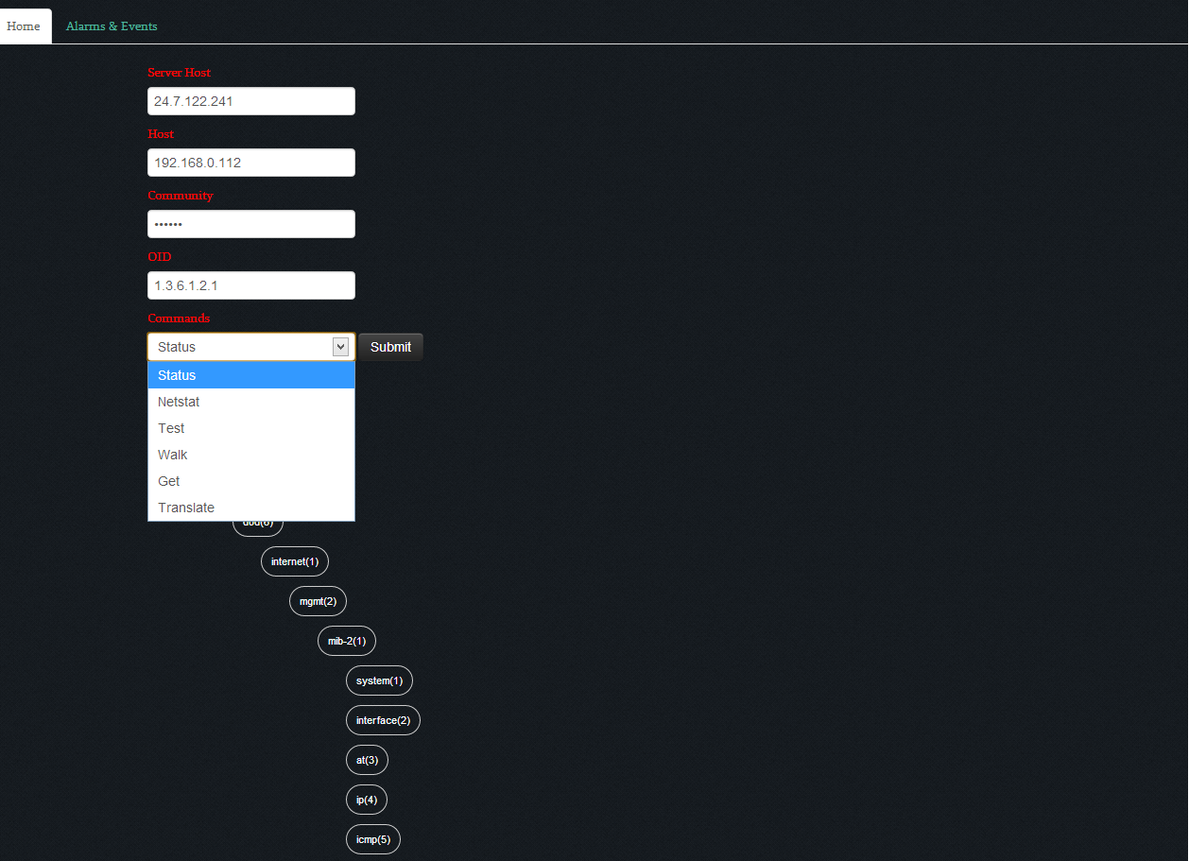
Basic SNMP Operations
User will be able to type the Application Server address (Server Host), network element address (Host Address), the community string, OID and select one of operations to perform
MIB Tree is also available for users to select and input particular OID by selecting it on the Tree

Slide 4
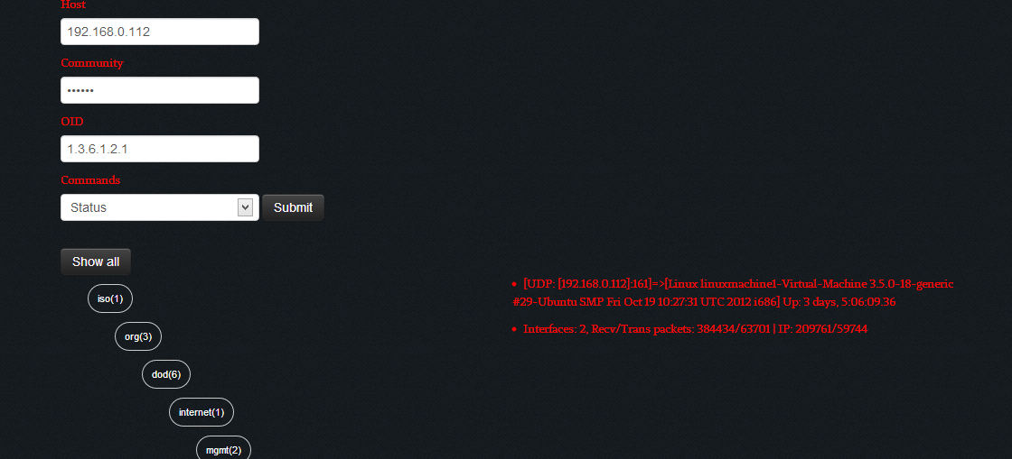
Basic SNMP Operations
A status operation is performed and results are shown

Slide 5
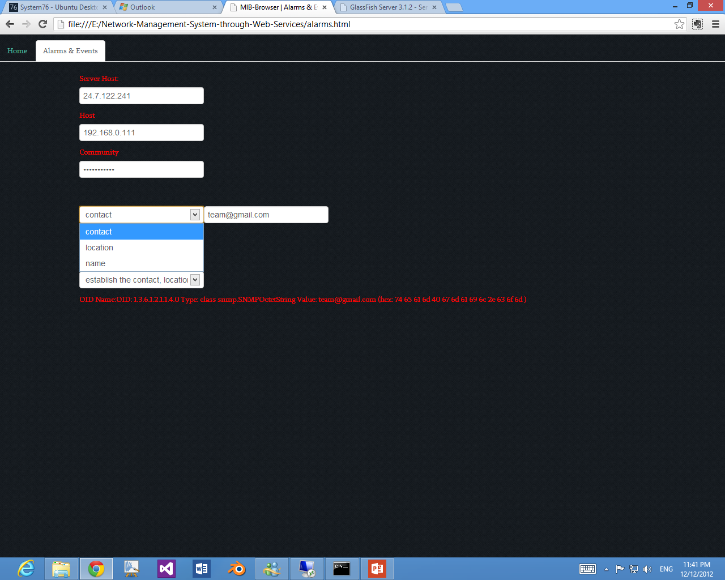
Change Location, Contact and System
User will be able to change the contact, location and name of a network element by using a community string that has written privilege

Slide 6
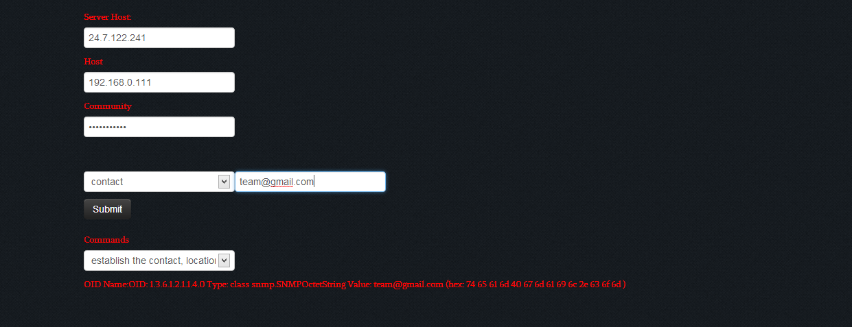
Change Location, Contact and System
An operation to change contact is performed and results to reflect the change is shown

Slide 7
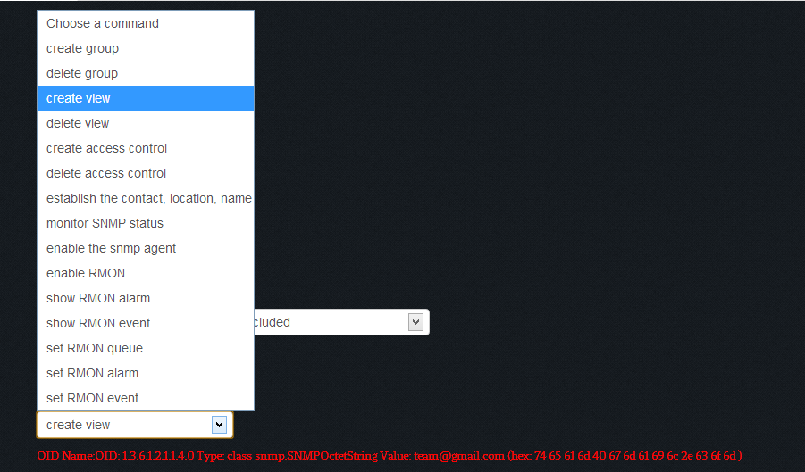
Access Control
User will be able to create/delete
Groups for existing security names
Views that specify a particular OID Tree
Access controls that links views with a group to control privileges for certain groups
User will only be able to perform these operations with a community string that has the written privilege

Slide 8
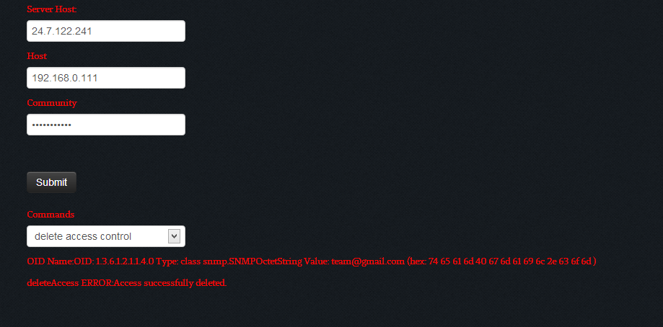
Access Control
A delete access control operation is performed and results are shown to reflect that the operation successes

Slide 9
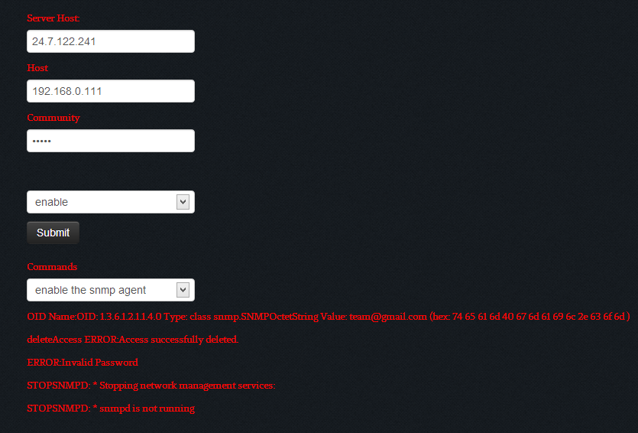
Enable/Disable Network Element
User will be able to disable/enable network elements with a community string that has this privilege

Slide 10
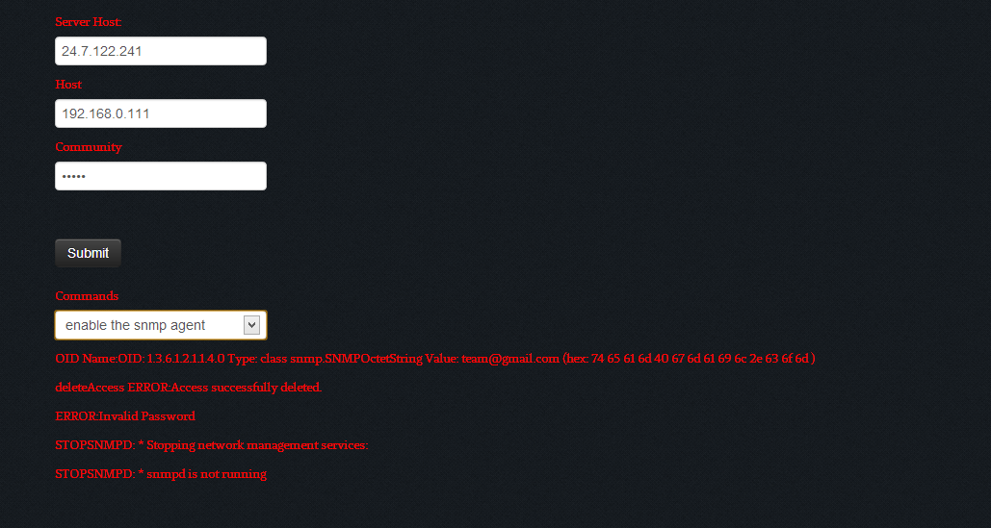
Enable/Disable Network Element
A disable SNMP agent operation is performed and results are shown to reflect that the operation successes

Slide 11
RMON Operations
Users will be able to perform basic RMON operations
Show RMON alarms
Show RMON events
Enable/disable RMON events (Not working)
Set RMON queue (Only be able to decrease the Queue, but not be able to decrease it)
Set RMON event (Not working)
Set RMON alarm (Not working)
User will only be able to perform these operations with a community string that has this particular privilege

Slide 12
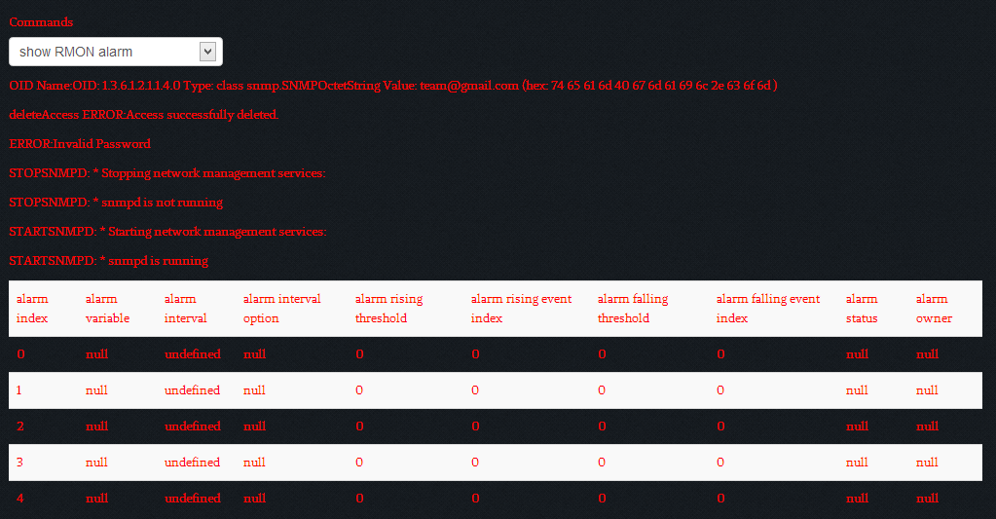
RMON Operations
A show RMON alarm operation is performed and results are shown as a table

Slide 13

Security with Secure Sockets Layer (SSL)
Communications between the application server and the frontend are protected with SSL
Browser will display the certificate as an invalid one since the certificate is a self – signed one instead of one that is singed by third – party Certificate Authority (CA)

Slide 14
The End
Thank you very much for viewing

